Slide 1
Good morning!
The 2nd of September.

Slide 2
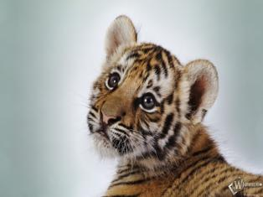
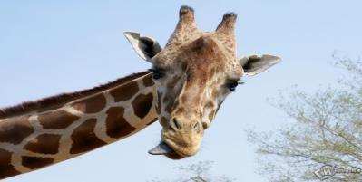
The questions
How are your today? …fine. …ok.
What day is it today? Today is the…
What day of the week is today? Today is …
What season is it now? It is…
What month is it now? It is…

Slide 3
Phonetic rule!
a) ee [і:] green;
ea [і:] clean;
b) ow [əʊ] snow, yellow;
c) ng [ŋ] spring.

Slide 4
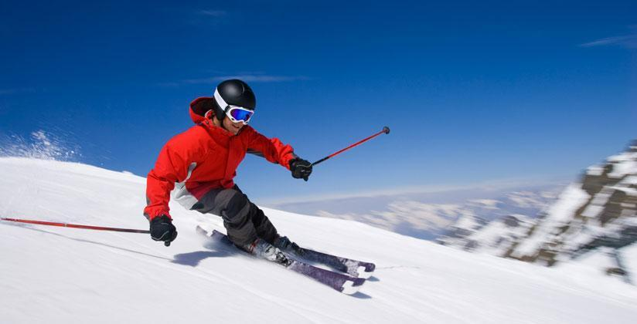
SKI

Slide 5
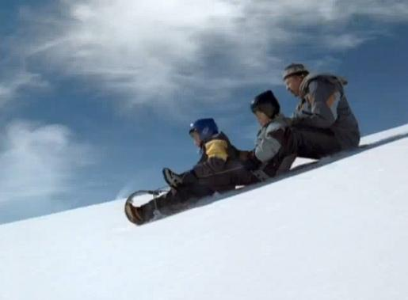
toboggan

Slide 6
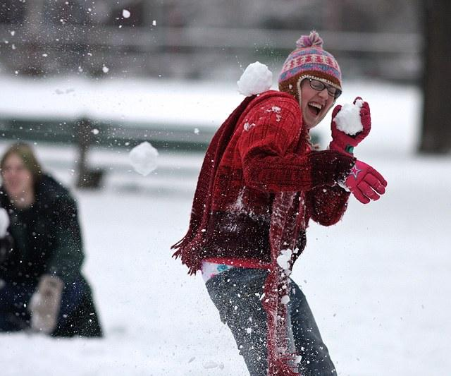
Play snowballs

Slide 7
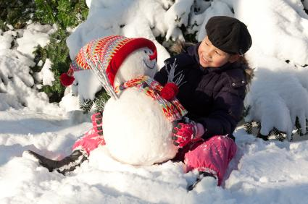
Make a snowman

Slide 8
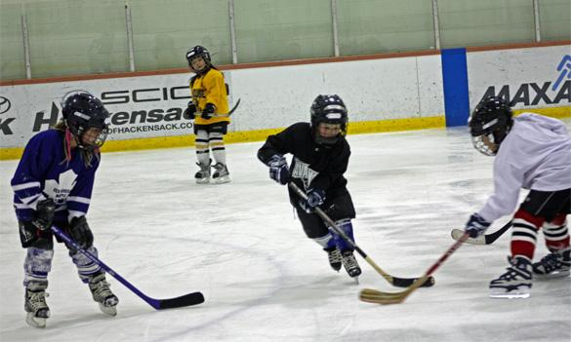
Play hockey

Slide 9
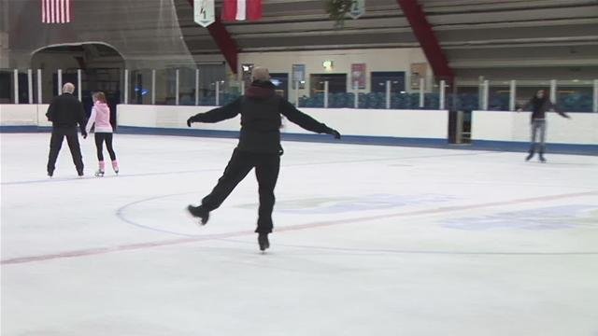
skate

Slide 10
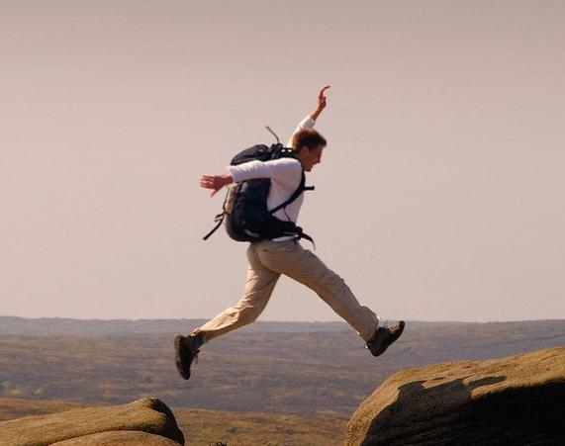
Jump

Slide 11
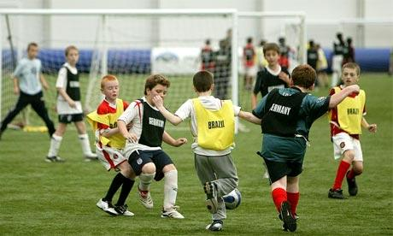
Play football

Slide 12
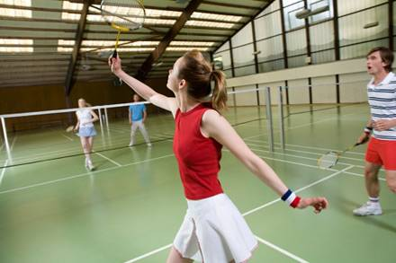
Play badminton

Slide 13
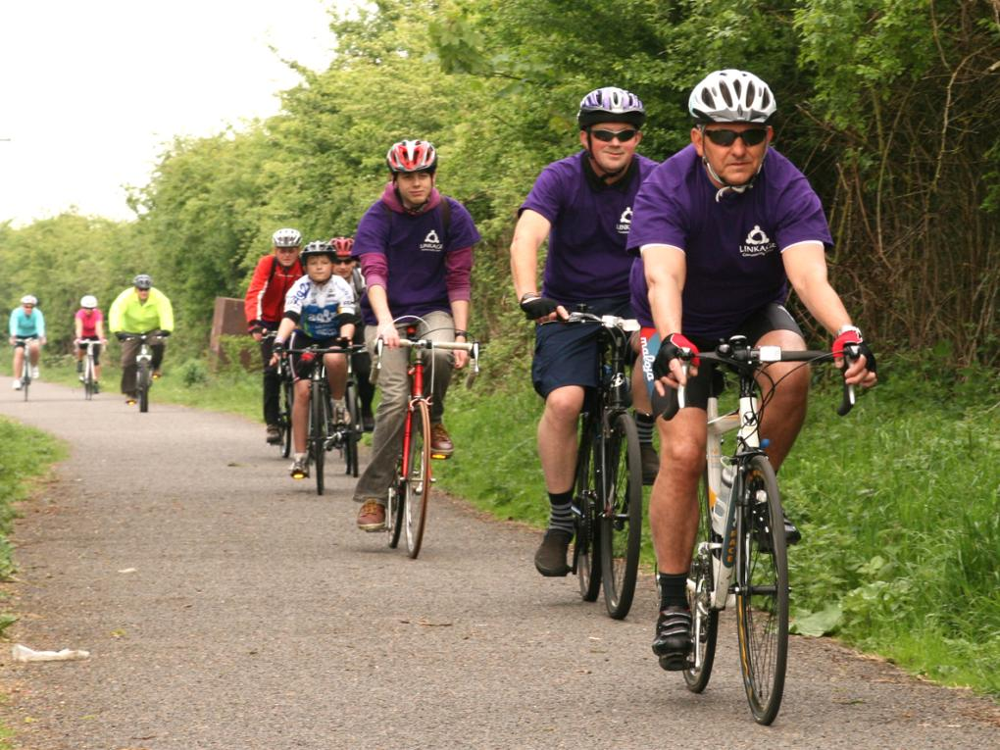
Ride a bike

Slide 14
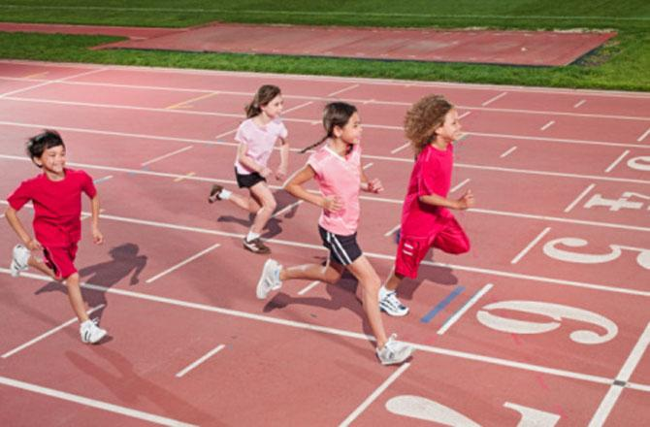
run

Slide 15
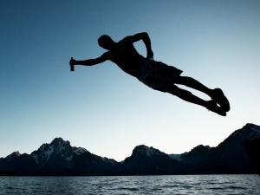
Dive

Slide 16
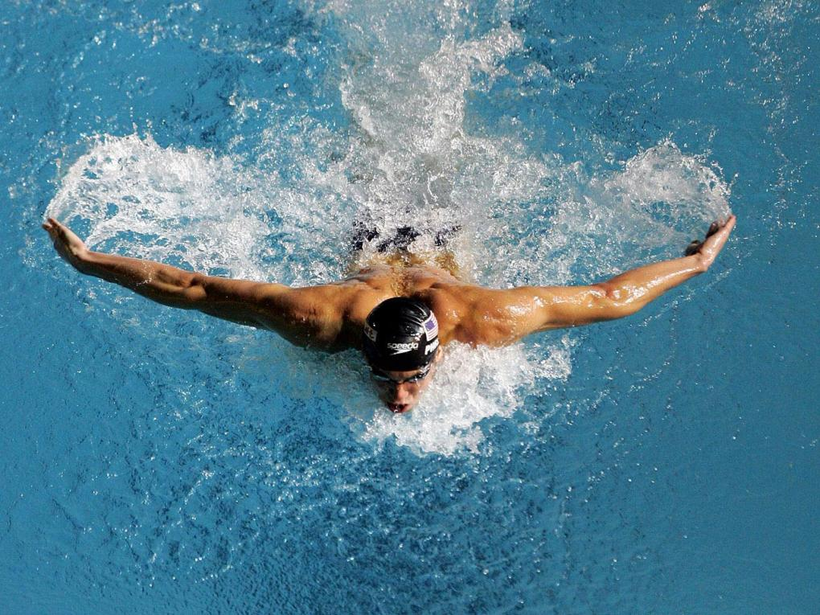
swim

Slide 17
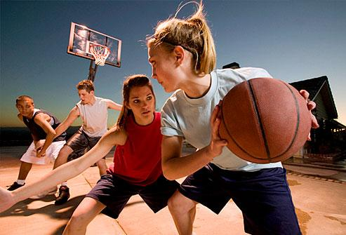
Play basketball

Slide 18
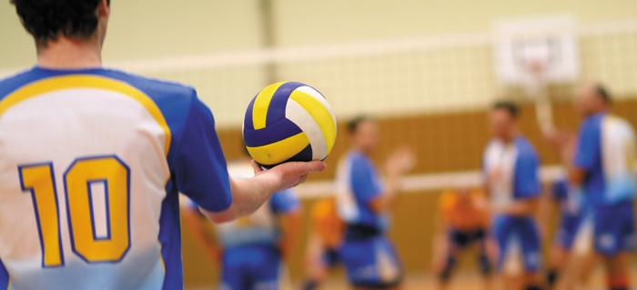
Pay volleyball

Slide 19
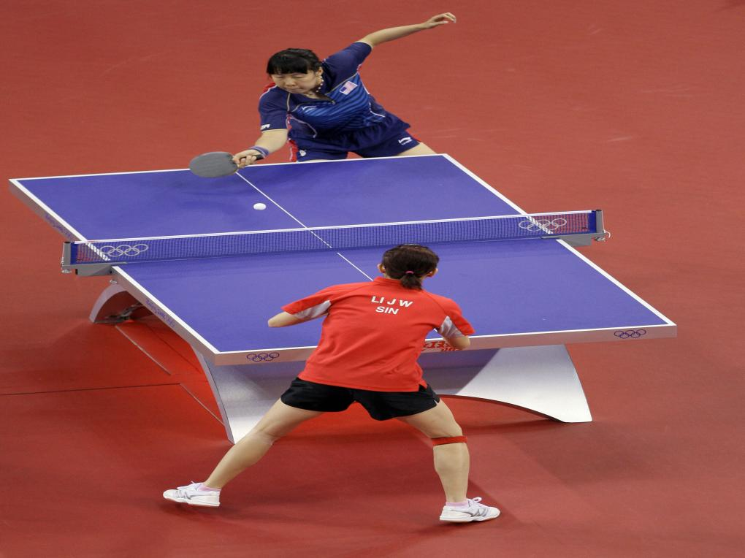
Play table tennis

Slide 20
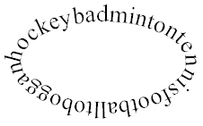
How many kinds of sport can your find in the word circle?

Slide 21
Ex. 3 p. 6
Example:
P₁. Do you like to skate in winter?
P₂. Do you like to toboggan in winter?
P₃. Do you like to play snowballs in winter?
P₄. What do you like to do in winter?

Slide 22
Ex. 5 p. 6
The keys.
Tiny likes to ski in winter. He likes to play table tennis in summer.
Billy likes to skate in winter. He likes to ride a bike in summer.
Martin likes to toboggan in winter. He likes to play badminton in summer.

